Slide 1
Chapter 3
Transport Layer
Transport Layer Security
(TLS)

Slide 2


Transport-layer security (TLS)
widely deployed security protocol above the transport layer
  supported by almost all browsers, web servers: https (port 443)
provides:
  confidentiality: via symmetric encryption
  integrity: via cryptographic hashing
  authentication: via public key cryptography
all techniques we have studied!
history:
  Secure Socket Layer (SSL) deprecated [2015]
  TLS 1.2 RFC 5246 [2008]
  TLS 1.3: RFC 8846 [2018]

Slide 3
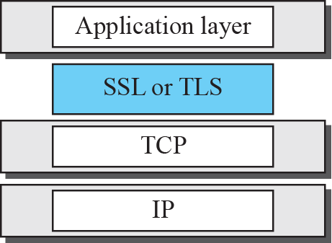
Figure 30.15 Location of SSL and TSL in the Internet mode

Slide 4

Transport-layer security: what’s needed?
let’s build a toy TLS protocol, t-tls, to see what’s needed!
we’ve seen the “pieces” already:
handshake: Alice, Bob use their certificates, private keys to authenticate each other, exchange or create shared secret
key derivation: Alice, Bob use shared secret to derive set of keys
data transfer: stream data transfer: data as a series of records
  not just one-time transactions
connection closure: special messages to securely close connection

Slide 5







t-tls: initial handshake
t-tls handshake phase:
Bob establishes TCP connection with Alice
Bob verifies that Alice is really Alice
Bob sends Alice a master secret key (MS), used to generate all other keys for TLS session
potential issues:
  3 RTT before client can start receiving data (including TCP handshake)
TCP SYN
SYNACK
ACK
t-tls hello
public key certificate
K_{B}⁺(MS) = EMS
client request
server reply

Slide 6

Transport-layer security (TLS)
TLS provides an API that any application can use
an HTTP view of TLS:
HTTP 1.0
HTTP/2
HTTP/2 (slimmed)
Application
HTTP/3
TLS
QUIC
Transport
TCP
TCP
UDP
Network
IP
IP
IP
HTTP/2 over TCP
HTTP/2 over TCP
HTTP/2 over QUIC
(which incorporates TLS)
over UDP

Slide 7









TLS 1.2 Handshake
Server
Client
Hello (Send supported cipher suite)
Hello (Selected cipher suite)
Certificate (Public Key)
Hello Done
Change Cipher Spec
Calculate Pre-master Secret
Receive Pre-master Secret
Key Exchange
Master Secret Generation
Master Secret Generation
Client Finished
Change Cipher Spec
Generate Master Secret
(Symmetric Key)
Generate Master Secret
(Symmetric Key)
Finished
🔒 Encrypted Data Transfer 🔒
Notes:
https://www.youtube.com/watch?v=cuR05y_2Gxc

Slide 8
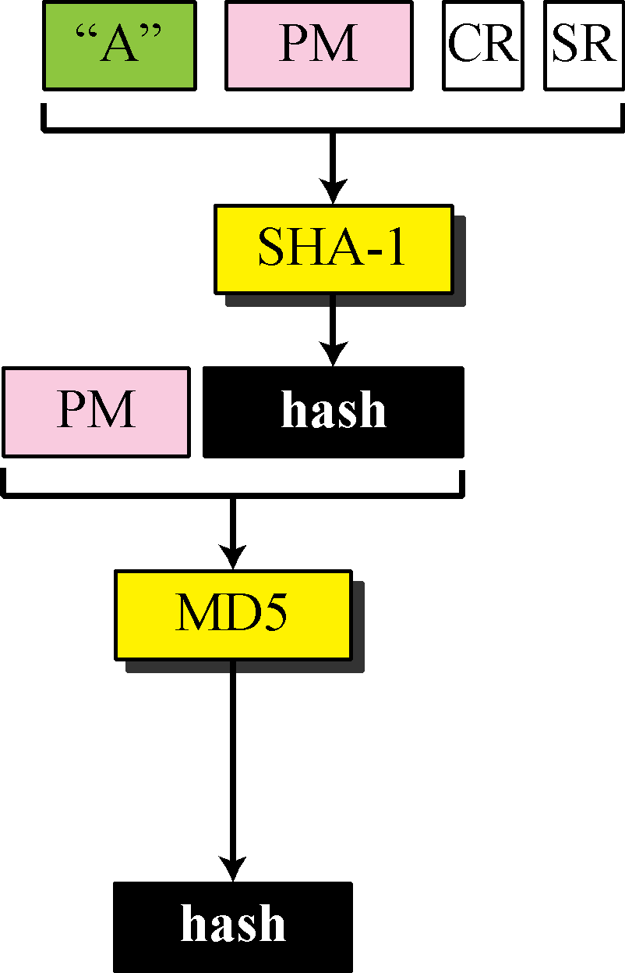
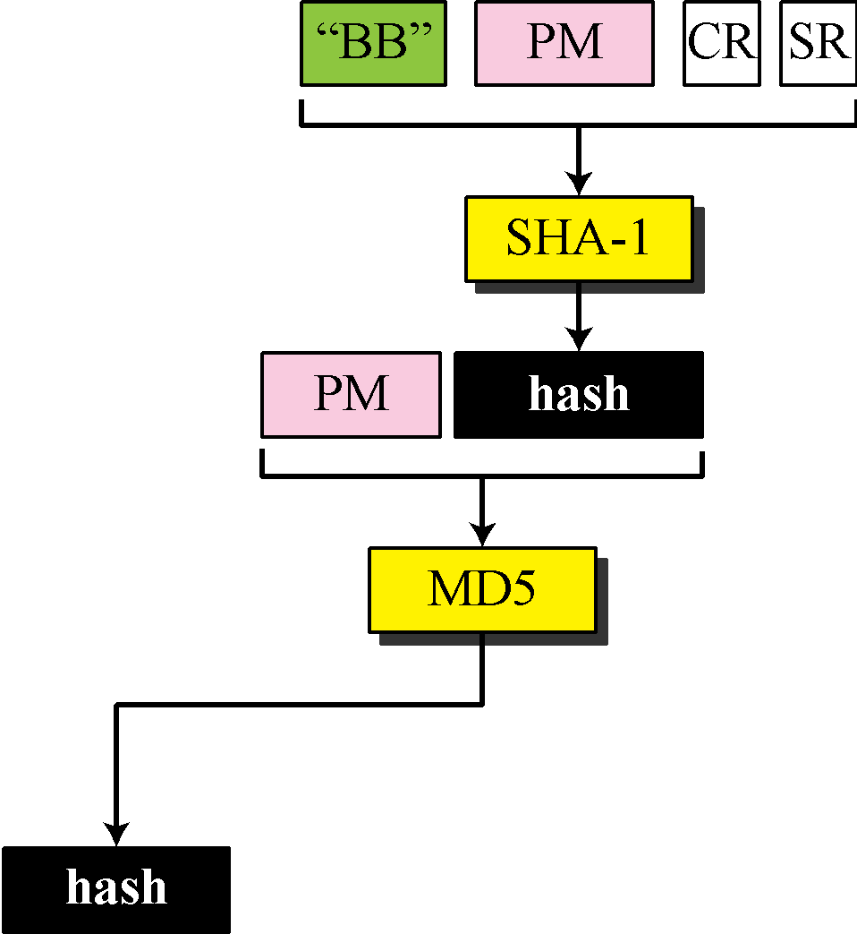
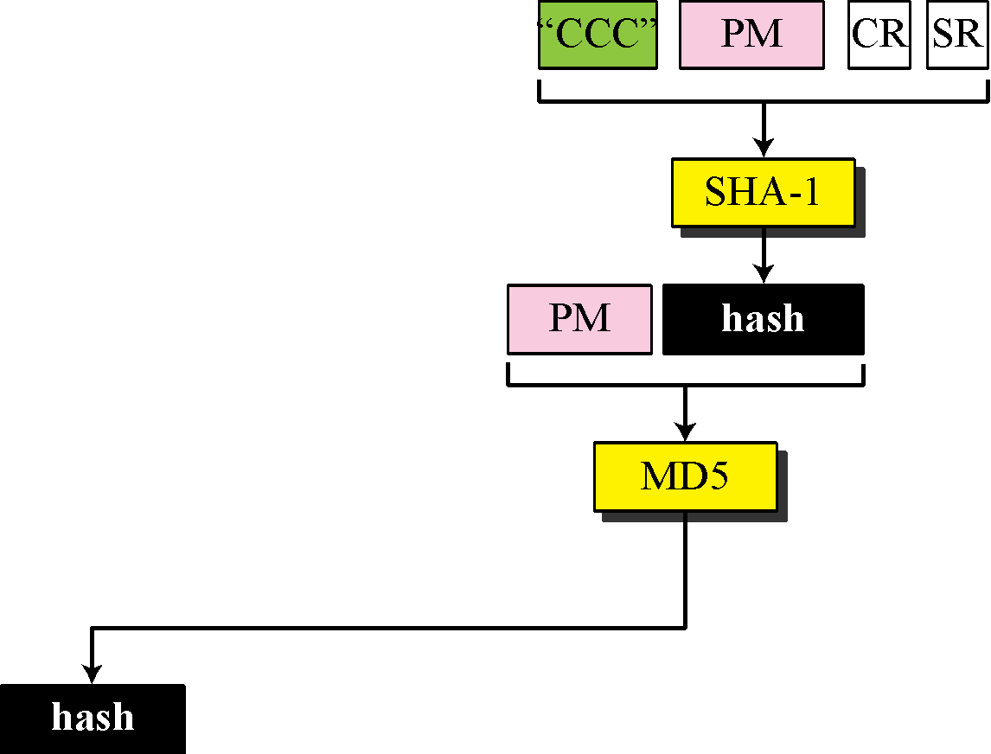
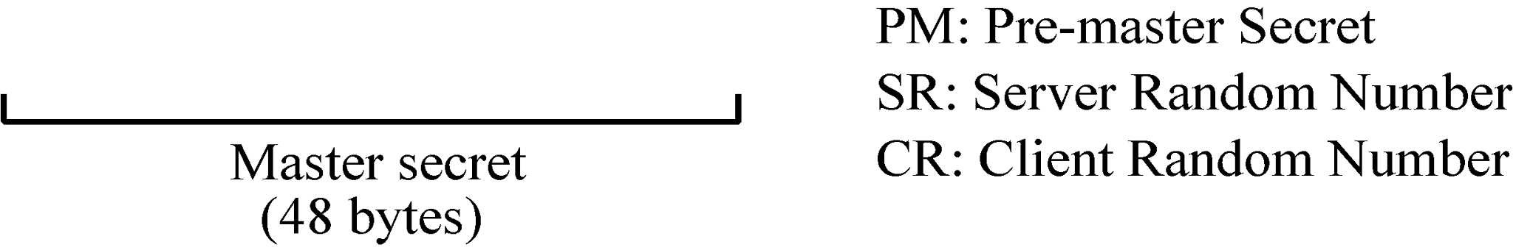
Figure 30.16 Calculation of maser key from pre-master secret

Slide 9
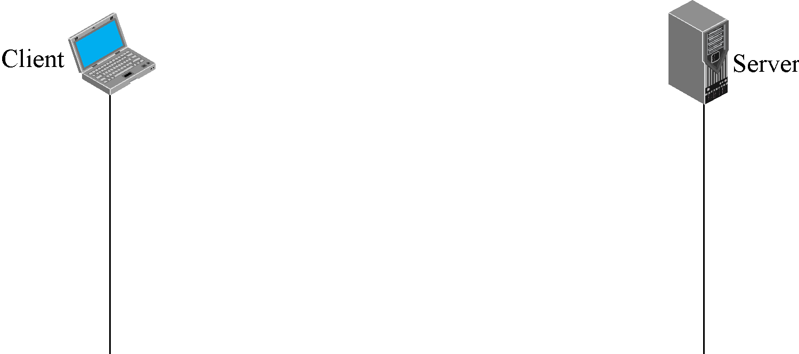

Figure 30.20 Handshake protocol

Slide 10

Note
After Phase I, the client and server know the version of SSL, the cryptographic algorithms, the compression method, and the two random numbers for key generation.

Slide 11
Note
After Phase II, the server is authenticated to the client, and
the client knows the public
key of the server if required.

Slide 12
Note
After Phase III, The client is authenticated for the serve, and
both the client and the server
know the pre-master secret.

Slide 13
TLS: 1.3 cipher suite
“cipher suite”: algorithms that can be used for key generation, encryption, MAC, digital signature
TLS: 1.3 (2018): more limited cipher suite choice than TLS 1.2 (2008)
  only 5 choices, rather than 37 choices
  requires Diffie-Hellman (DH) for key exchange, rather than DH or RSA
  combined encryption and authentication algorithm (“authenticated encryption”) for data rather than serial encryption, authentication
    4 based on AES
  HMAC uses SHA (256 or 284) cryptographic hash function

Slide 14





TLS 1.3 handshake: 1 RTT
1
client TLS hello msg:
guesses key agreement protocol, parameters
indicates cipher suites it supports
client hello:
supported cipher suites
DH key agreement protocol, parameters
1
2
server TLS hello msg chooses
key agreement protocol, parameters
cipher suite
server-signed certificate
server hello:
selected cipher suite
DH key agreement protocol, parameters
2
3
3
client:
checks server certificate
generates key
can now make application request (e.g.., HTTPS GET)
client
server

Slide 15





TLS 1.3 handshake: 0 RTT
initial hello message contains encrypted application data!
“resuming” earlier connection between client and server
application data encrypted using “resumption master secret” from earlier connection
vulnerable to replay attacks!
maybe OK for get HTTP GET or client requests not modifying server state
client hello:
supported cipher suites
DH key agreement protocol, parameters
application data
server hello:
selected cipher suite
DH key agreement protocol, parameters
application data (reply)
client
server

Slide 16
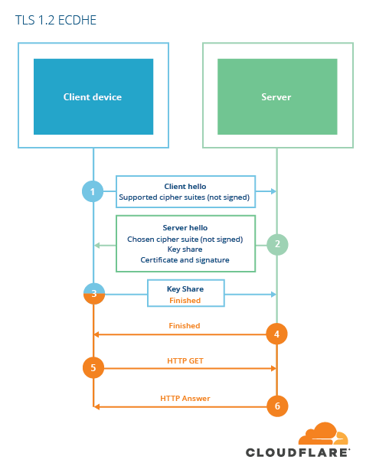
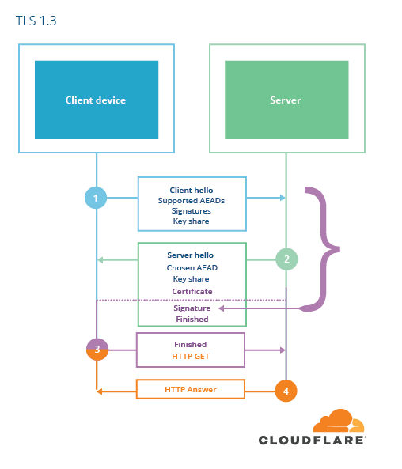

TLS 1.2 vs TLS 1.3

Slide 17
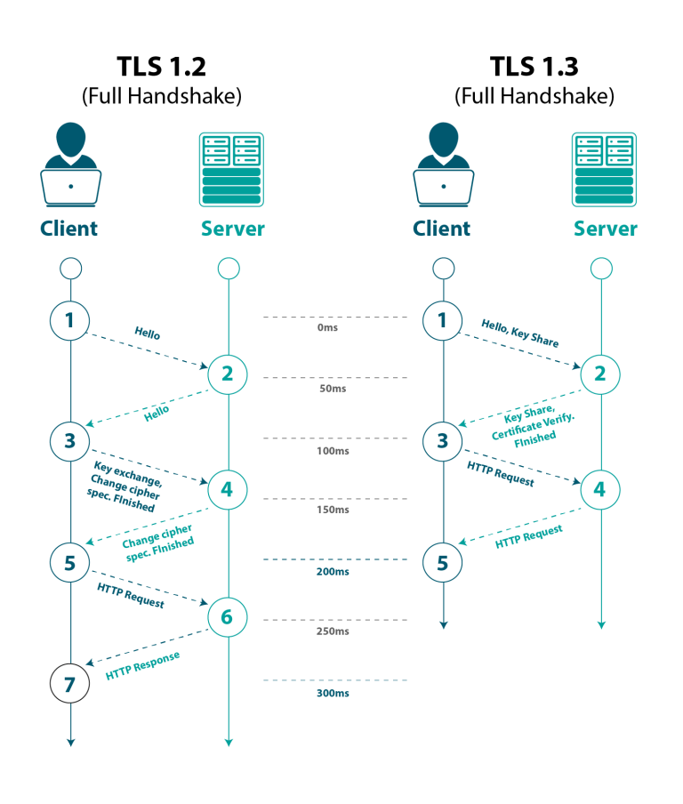

TLS 1.2 vs TLS 1.3

Slide 18
References
1. Computer Networking: A Top-Down Approach (Chapter 8)
2. Breaking Down the TLS 1.2 Handshake
3. TLS 1.3 Handshake
4. https://blog.cloudflare.com/rfc-8446-aka-tls-1-3/

